Slide 1
Lecture 10
Sidra Khatoon

Slide 2
Authentication and Authorization
With the help of front-end development services, we can implement authentication & authorization protocols in the Flutter application to ensure that only authorized users can access sensitive data or features.
Authentication is the process of verifying the identity of a user.
The most common methods are basic authentication, token-based authentication, and OAuth 2.0.
Authorization is granting access to resources based on the user’s authentication credentials.

Slide 3
How to secure your flutter application
Here are some other ways to secure your Flutter application:
Use a trusted authentication system: You can consider using systems that have already been built & tested, such as Firebase Authentication. This will ensure it’s easy for users to log in and safe from hackers.
Control who can do what: To ensure that the person assigned to a task can perform it, you can use role-based access control. This helps prevent anyone from doing things they shouldn’t, whether accidentally or intentionally.
Protect crucial information: Ensure that things like passwords & special keys are stored in a safe way using suitable encryption methods.
Restrict unauthorized access: Use rate limiting to make it harder for hackers to try many different passwords until they find the right one.

Slide 4
Data Encryption
Whether it’s a mobile app or a web app, encryption is a crucial security strategy for any platform. It protects users’ data by making it unreadable to unauthorized people. In the context of a Flutter app, data encryption can protect sensitive data, such as user passwords or API keys, stored on the client or server side.
By using Flutter apps’ most common encryption algorithms, such as Advanced Encryption Standard (AES) or RSA, you can ensure that the data is effectively protected from unauthorized access.
Don’t forget to consider the security of your keys, as they are responsible for encrypting and decrypting data. They should store securely and not share all encryption keys with anyone else
Data encryption is a crucial measure for app security. You can protect data from possible threats by utilizing encryption libraries, implementing encryption algorithms directly, or using secure storage options provided by the platform.
It is imperative to take these precautions to maintain the integrity and confidentiality of sensitive information.

Slide 5
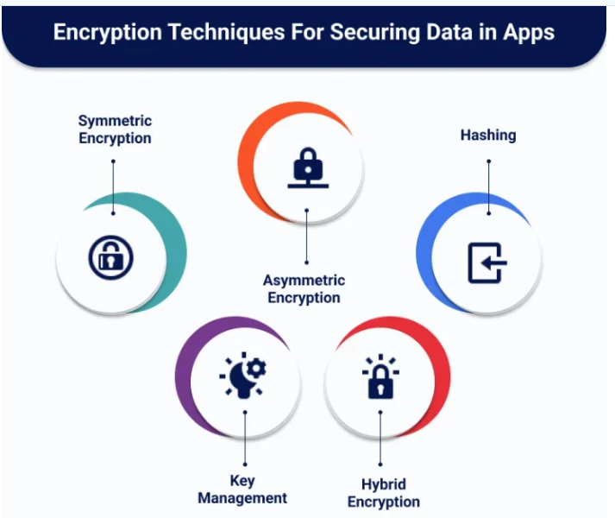

Slide 6
Secure Storage of Sensitive Data
The secure storage of sensitive data is paramount for your Flutter application. Anytime data is transmitted or stored, confirm it’s properly encrypted and secured to prevent unauthorized access or theft.
A great way to achieve this is to use Flutter Encrypt, a plugin for Flutter apps that allows developers to encrypt and securely store sensitive data easily. By utilizing this plugin; you can be certain that there will be no malicious entities can access the sensitive data stored within our clients’ apps.
Also, this method can be used with other technologies, such as Firebase and Auth0, to provide an extra layer of security. With the proper techniques, you can ensure your users’ information will remain safe & secure.

Slide 7
Obfuscation & Code Minification
Obfuscation and code minification can provide additional layers of security to your Flutter app. Obfuscation is the process of making code difficult to comprehend and reverse engineer. Code minification is a process of removing unnecessary code or data from a program so that it runs faster.
Obfuscation is a great way to protect your source code from reverse engineering, which can be used to exploit your system. It helps by making it difficult for hackers to understand the code’s purpose and structure, as well as its inputs and outputs. This makes it more challenging for a hacker to access your system.
Code minification is also beneficial for security, as it reduces the size of the code, making it more difficult for attackers to read and decipher. In addition, code minification can help make your code run faster by reducing the amount of data that needs to be processed by the machine.
Using obfuscation and code minification together can provide a strong layer of security for your Flutter Web Apps, Flutter Flow, and mobile app development services. They are essential for any security strategy, as they can help make your code more secure and protect your system from malicious actors.

Slide 8
How to Build a Secure User Authentication Flow in Flutter with Firebase
User authentication is critical to mobile app development. It helps make sure that only authorized users can access sensitive information and perform actions within an application.
To build secure user authentication in Flutter using Firebase for authentication
We can implement a secure login and sign-up process by integrating Firebase authentication.

Slide 9
How Firebase Authentication Works
Firebase Authentication is a powerful service that simplifies the process of authenticating users in your app.
It supports various authentication methods, including email/password, social media, and more.
One of the key advantages of Firebase Authentication is its built-in security features, such as secure storage of user credentials and encryption of sensitive data.
The image on next slide is a flowchart to visualize the flow of the app let's discuss what each parts represents.
The rounded rectangles represent the starting and ending points of the flow; the purple rectangles represent the screens; the light blue rectangles represent the processes that take place; and finally, the rhombus represents decision-making.

Slide 10
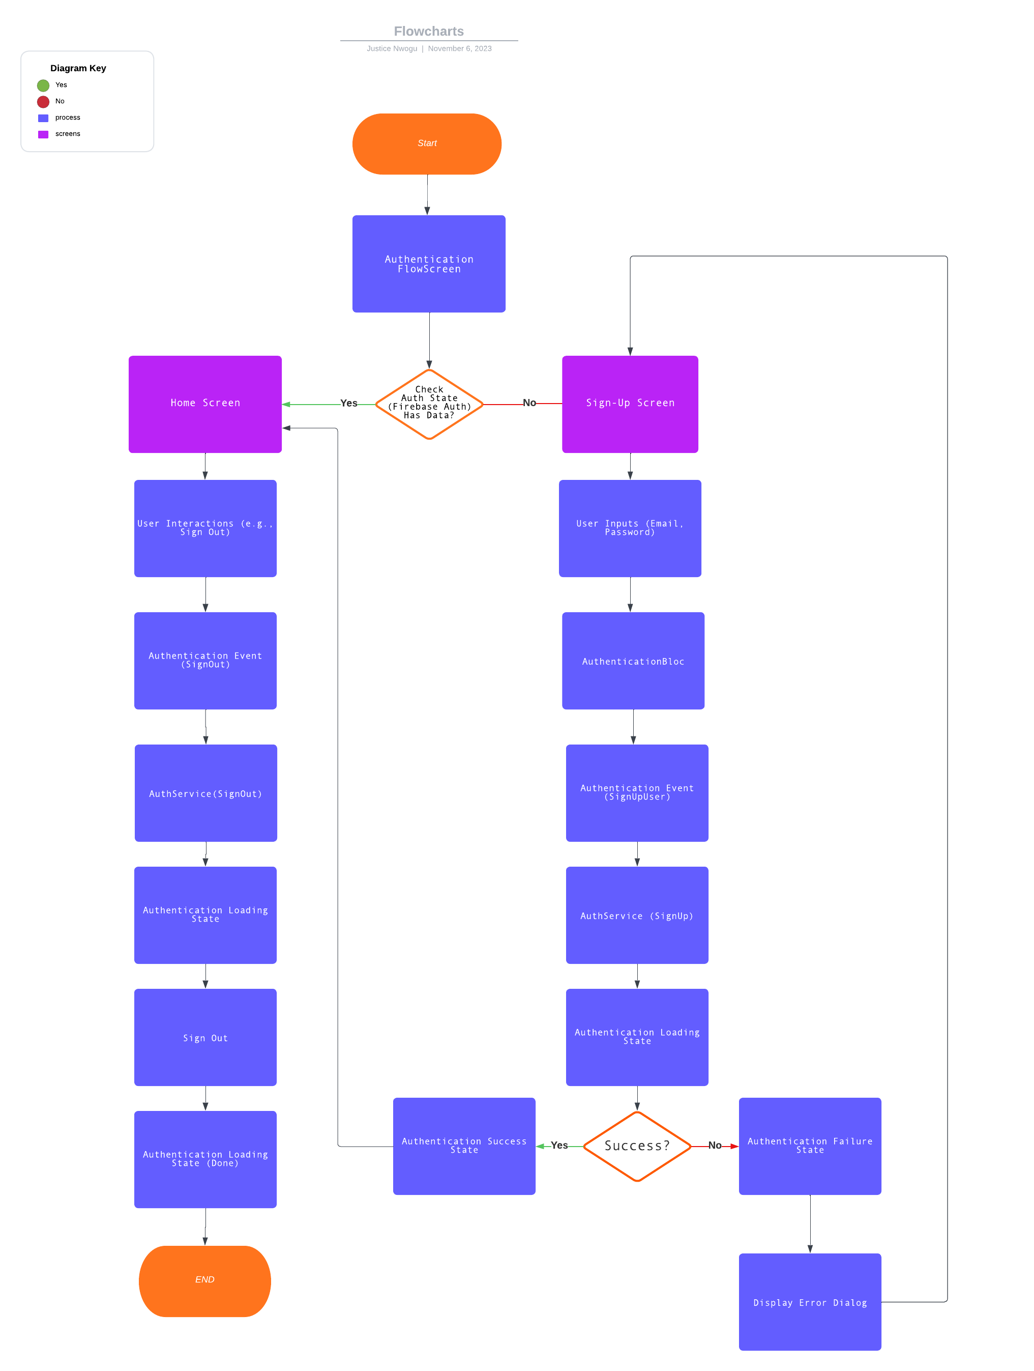

Slide 11
How Firebase Authentication Works
The application starts at the AuthenticationFlowScreen.
The StreamBuilder listens to authentication state changes.
If a user is authenticated, it directs to the HomeScreen; otherwise, it leads to the SignupScreen.
AuthenticationBloc manages user authentication events and states.
When the user signs up (SignUpUser event is triggered):
It initiates the authentication loading state (AuthenticationLoadingState).
Calls signUpUser from AuthService for user registration.
If successful, it emits AuthenticationSuccessState with user data; otherwise, emits AuthenticationFailureState.
When the user initiates the sign-out process (SignOut event is triggered):
It starts the authentication loading state (AuthenticationLoadingState).
Calls signOutUser from AuthService to sign the user out.
If an error occurs during sign-out, it logs the error message.

